Slide 1
Learning Roadmap System
Karan Sood– RA2211026010016
Sanket Dhumal– RA2211026010020
Pratham Sharma– RA2211026010022
Aditya Nair– RA2211026010027

Slide 2
Problem Statement
Students often struggle to manage their academic tasks effectively due to a lack of structured planning tools and personalized academic support. Traditional systems or manual methods used for organizing study schedules are inefficient, leading to missed deadlines, poor time management, and reduced academic performance. There is a pressing need for a digital solution that allows students to seamlessly plan, organize, and track their study activities while adapting to their unique academic needs and learning pace.
To address these gaps, the Learning Roadmap System project aims to build a secure, responsive, and data-driven application that supports students in planning their academic journey efficiently.

Slide 3
Key Features
Task & Study Planning- Students can create and manage to-do lists, with tasks added automatically based on performance. Tasks are easily trackable and organized by subject, date, or importance for efficient study planning.
Performance-Based Support- The planner provides insights from past performance and recommends tasks or resources to help students improve weak areas. It also gives reminders when scores drop in specific subjects.
Analytics & Monitoring- It tracks how students perform over time, shows task completion stats, and highlights areas for improvement. This motivates students to stay consistent and adjust their study habits as needed.
Authentication & Security- Secure login and registration features protect user data. Proper input validation and session management ensure a safe and private experience.
Mobile & User Experience- The interface is fully responsive, offering a smooth experience on mobile. Students can easily manage tasks on the go by adding, editing, or deleting them from their devices.
Search & Discovery- An intelligent search bar with filters helps students quickly find tasks, subjects, or resources, improving accessibility and saving time.
Feedback & Engagement- The system collects user feedback to understand what features work well and what needs improvement, allowing for a better, user-focused experience.

Slide 4
Target Audience
Parents want to track their child’s academic performance, task completion, and consistency.
Students (School & College):
Those who want to create, view, and manage study-related tasks.
Need to organize their academic schedule efficiently.
Want personalized study recommendations based on performance.
Academic Stakeholders:
Educators or academic advisors who want to gain insights into student performance.
Interested in using analytics for improving academic support systems.
Parents:
Want to track their child’s academic performance, task completion, and consistency.
Helps them stay involved and offer support when needed.
Want visibility into the study plan, important deadlines, and upcoming exams.

Slide 5
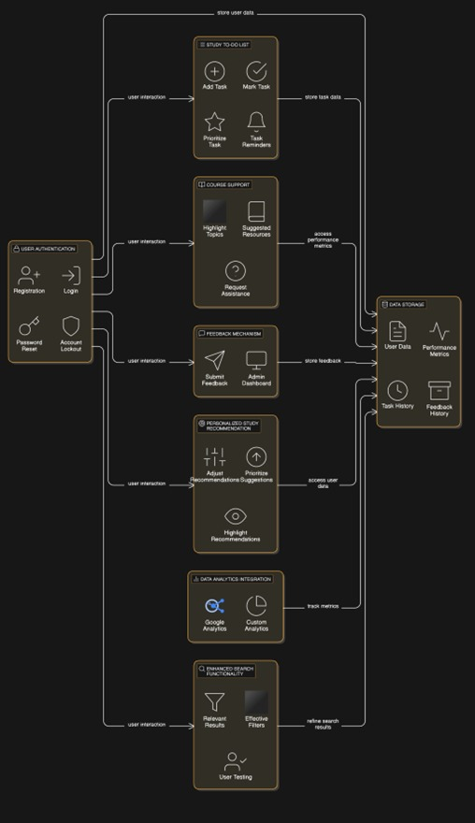
System Architecture

Slide 6
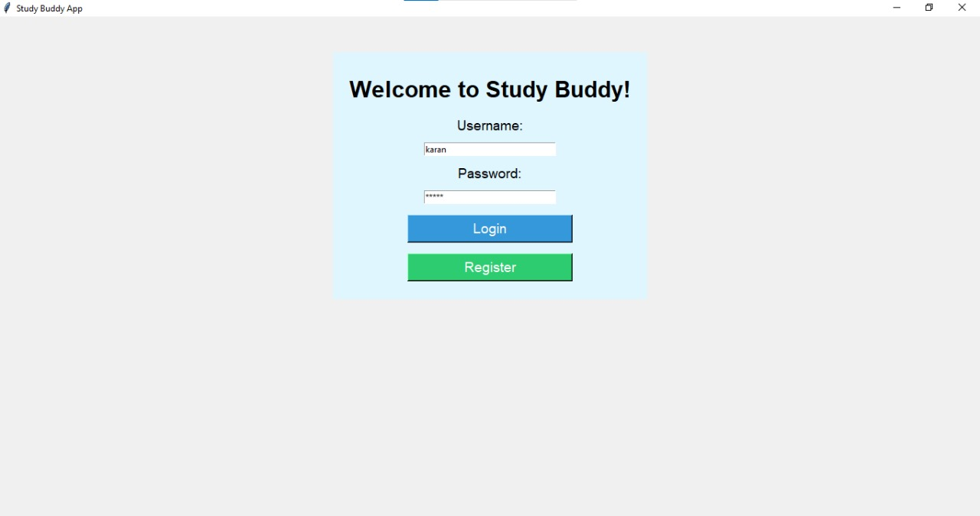
Screenshots of Learning Roadmap System

Slide 7
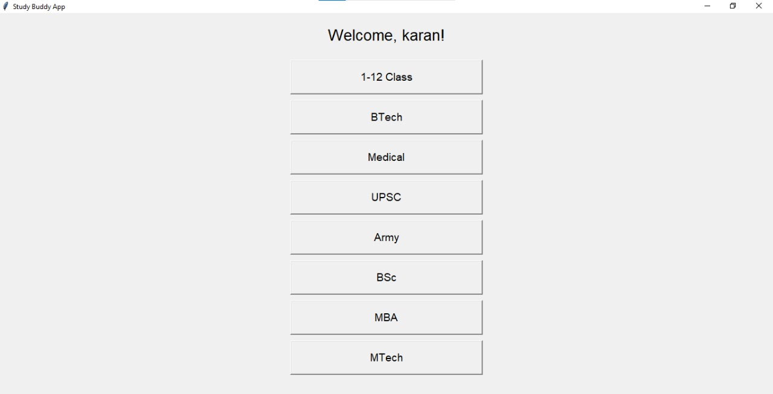
Screenshots of Learning Roadmap System

Slide 8
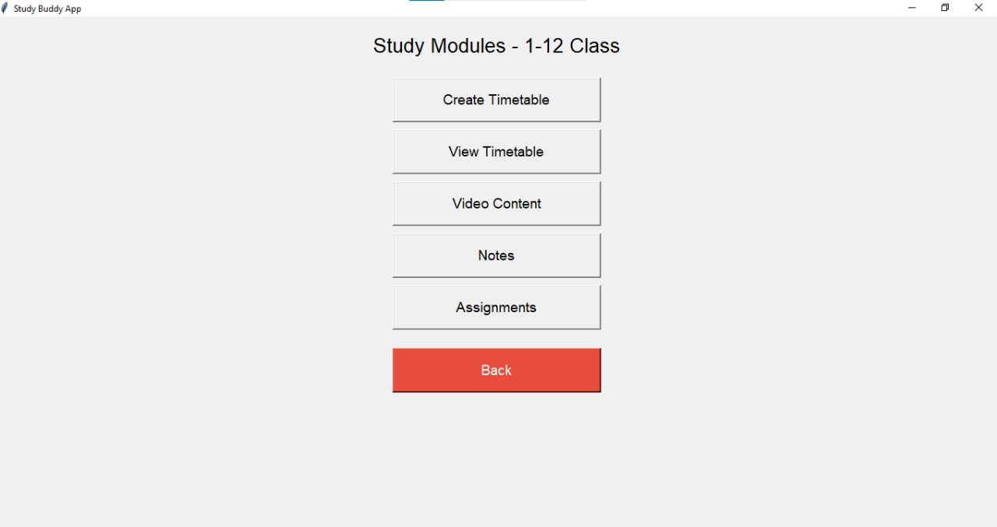
Screenshots of Learning Roadmap System

Slide 9
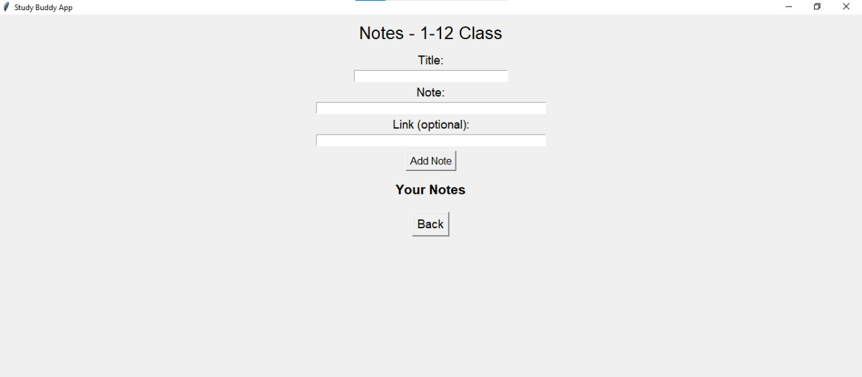
Screenshots of Learning Roadmap System

Slide 10
Conclusion
The Learning Roadmap System application is a smart and student-centric solution aimed at enhancing academic productivity through effective task management, personalized recommendations, and real-time performance tracking. It is tailored for students who need to plan, organize, and optimize their study schedules, while also involving parents and educators in the academic journey through insightful analytics and feedback mechanisms. Features like notifications and AI-driven recommendations help students stay focused and receive timely guidance. Overall, the Learning Roadmap System empowers users to make informed decisions, stay consistent with their goals, and fosters a collaborative environment for academic success.

Slide 11
THANK YOU !

